Slide 1
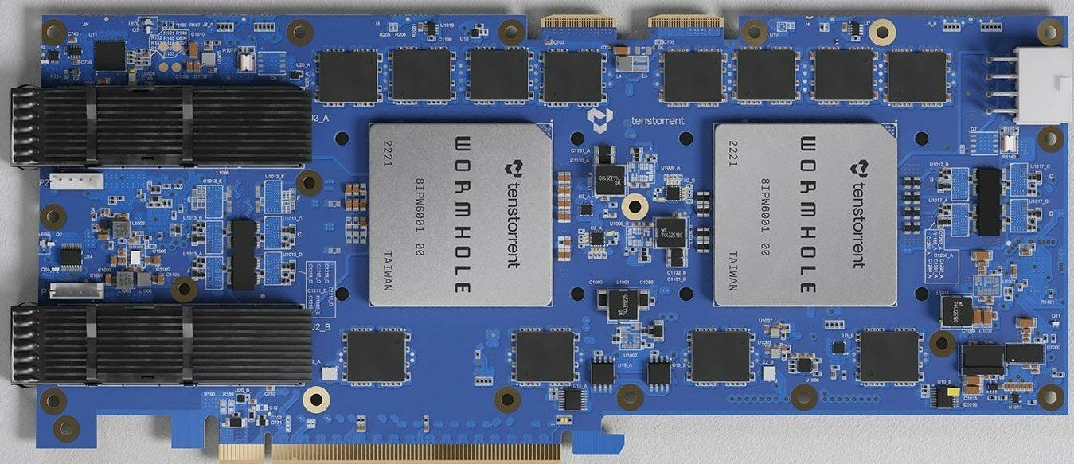


Accessing the Tenstorrent device

Slide 2

Using the EPCC RISC-V testbed
We host a testbed system that enables developers to experiment with RISC-V
https://riscv.epcc.ed.ac.uk
Lots of different RISC-V technologies, but this also contains Wormhole and Blackhole PCIe accelerators
This week and next our compute facility is offline due to power maintenance works, so we are currently using a single Wormhole for the tutorial and access instructions are slightly different than they normally are

Slide 3
Everyone has a visitor account on the machine
We will provide the details of this to you now
Everything is set up in this account so that you can work with the practicals
You can then use Putty (on Windows) or your inbuilt SSH client (on Linux or MacOS) to SSH into the remote machine

Slide 4
Let’s access the machine
Step one – using the visitor account assigned to you, access the login node
ssh user-id@riscv-login.epcc.ed.ac.uk
You are now logged into the login node
Step two – SSH to tenstorrent Wormhole machine
[user-id@riscv-login ~]$ ssh tenstorrent1
Let one of the tutors know if you are struggling with this

Slide 5
We have set some files up for you already….
[user-id@tenstorrent1 ~]$ ls
tt-metal-0.62.2 tt-tutorial
The tt-metal-0.62.2 directory contains the Tenstorrent software stack
You don’t need to worry too much about this, but if you issue export you will see that there are some paths (e.g. TT_METAL_HOME) set up which point into this
We will be working with the tt-tutorial directory today which contains the practicals
These correspond to practicals one through five that we will work with today
[user-id@tenstorrent1 ~]$ cd tt-tutorial
[user-id@tenstorrent1 ~/tt-tutorial]$ ls
Lectures LICENCE practical README
[user-id@tenstorrent1 ~/tt-tutorial]$ cd practical
[user-id@tenstorrent1 ~/tt-tutorial/practical]$ ls
five four general one README.md three two

Slide 6
A really useful tool
Tenstorrent System Management Interface (TT-SMI) is a command line utility that enables us to interact with Tenstorrent devices connected to a host
Brings up an ncurses dialog with information about the card, including telemetry (e.g. power draw, temperature, clock frequency)
Most usefully this can be used to reset the device if it hangs/gets stuck
Please don’t use this during the tutorial (unless it really gets stuck!) as multiple people will be running on the same device, so you might reset their run!
[user-id@tenstorrent1 ~]$ tt-smi
[user-id@tenstorrent1 ~]$ tt-smi -r

Slide 7
Sharing the Wormhole: Your executable is running
[user-id@tenstorrent1 ~]$ ./ex_five
2025-09-01 18:38:54.566 | info | SiliconDriver | Opened PCI device 0; KMD version: 1.29.0; API: 1; IOMMU: disabled (pci_device.cpp:197)
2025-09-01 18:38:54.579 | info | Device | Opening user mode device driver (tt_cluster.cpp:192)
2025-09-01 18:38:54.579 | info | SiliconDriver | Opened PCI device 0; KMD version: 1.29.0; API: 1; IOMMU: disabled (pci_device.cpp:197)
2025-09-01 18:38:54.590 | info | SiliconDriver | Opened PCI device 0; KMD version: 1.29.0; API: 1; IOMMU: disabled (pci_device.cpp:197)
2025-09-01 18:38:54.601 | info | SiliconDriver | Harvesting mask for chip 0 is 0x300 (NOC0: 0x300, simulated harvesting mask: 0x0). (cluster.cpp:295)
2025-09-01 18:38:54.603 | info | SiliconDriver | Opened PCI device 0; KMD version: 1.29.0; API: 1; IOMMU: disabled (pci_device.cpp:197)
2025-09-01 18:38:54.699 | info | SiliconDriver | Harvesting mask for chip 1 is 0x204 (NOC0: 0x204, simulated harvesting mask: 0x0). (cluster.cpp:295)
2025-09-01 18:38:54.702 | info | SiliconDriver | Opening local chip ids/pci ids: {0}/[0] and remote chip ids {1} (cluster.cpp:157)
2025-09-01 18:38:54.705 | info | SiliconDriver | All devices in cluster running firmware version: 255.255.0 (cluster.cpp:138)
2025-09-01 18:38:54.705 | info | SiliconDriver | Software version 6.0.0, Ethernet FW version 6.9.0 (Device 0) (cluster.cpp:935)
2025-09-01 18:38:54.705 | info | SiliconDriver | Software version 6.0.0, Ethernet FW version 6.9.0 (Device 1) (cluster.cpp:935)
Completed successfully on the device, with 65536 elements
2025-09-01 18:38:58.053 | info | Device | Closing user mode device drivers (tt_cluster.cpp:383)
Tenstorrent’s kernel driver protects against users concurrently running, but this is a little rudimentary

Slide 8
Sharing the Wormhole: Conflict, you are not running
[user-id@tenstorrent1 ~]$ ./ex_five
2025-09-01 18:38:19.201 | info | SiliconDriver | Opened PCI device 0; KMD version: 1.29.0; API: 1; IOMMU: disabled (pci_device.cpp:197)
2025-09-01 18:38:19.214 | info | Device | Opening user mode device driver (tt_cluster.cpp:192)
2025-09-01 18:38:19.214 | info | SiliconDriver | Opened PCI device 0; KMD version: 1.29.0; API: 1; IOMMU: disabled (pci_device.cpp:197)
2025-09-01 18:38:19.224 | info | SiliconDriver | Opened PCI device 0; KMD version: 1.29.0; API: 1; IOMMU: disabled (pci_device.cpp:197)
2025-09-01 18:38:19.234 | info | SiliconDriver | Harvesting mask for chip 0 is 0x300 (NOC0: 0x300, simulated harvesting mask: 0x0). (cluster.cpp:295)
2025-09-01 18:38:19.236 | info | SiliconDriver | Opened PCI device 0; KMD version: 1.29.0; API: 1; IOMMU: disabled (pci_device.cpp:197)
2025-09-01 18:38:19.341 | info | SiliconDriver | Harvesting mask for chip 1 is 0x204 (NOC0: 0x204, simulated harvesting mask: 0x0). (cluster.cpp:295)
2025-09-01 18:38:19.346 | info | SiliconDriver | Opening local chip ids/pci ids: {0}/[0] and remote chip ids {1} (cluster.cpp:157)
2025-09-01 18:38:19.347 | info | SiliconDriver | All devices in cluster running firmware version: 255.255.0 (cluster.cpp:138)
2025-09-01 18:38:19.347 | info | SiliconDriver | Software version 6.0.0, Ethernet FW version 6.9.0 (Device 0) (cluster.cpp:935)
2025-09-01 18:38:19.348 | info | SiliconDriver | Software version 6.0.0, Ethernet FW version 6.9.0 (Device 1) (cluster.cpp:935)
2025-09-01 18:38:20.081 | info | Metal | While initializing device 0, active ethernet dispatch core (x=21,y=17) detected as still running, issuing exit signal. (metal_context.cpp:586)
2025-09-01 18:38:20.082 | info | Metal | While initializing device 0, active ethernet dispatch core (x=18,y=17) detected as still running, issuing exit signal. (metal_context.cpp:586)
2025-09-01 18:38:20.082 | info | Metal | While initializing device 0, active ethernet dispatch core (x=25,y=17) detected as still running, issuing exit signal. (metal_context.cpp:586)
Read unexpected run_mailbox value: 0x40 (expected 0x80 or 0x0)
2025-09-01 18:38:20.082 | critical | Always | Read unexpected run_mailbox value from core (x=25,y=17) (assert.hpp:107)
2025-09-01 18:38:20.082 | warning | Always | Detected dispatch kernels still running but failed to complete an early exit. This may happen from time to time following a reset, continuing to FW intialization... (metal_context.cpp:632)
2025-09-01 18:38:20.088 | info | Metal | While initializing device 1, active ethernet dispatch core (x=18,y=16) detected as still running, issuing exit signal. (metal_context.cpp:586)
2025-09-01 18:38:20.088 | info | Metal | While initializing device 1, active ethernet dispatch core (x=25,y=16) detected as still running, issuing exit signal. (metal_context.cpp:586)
Read unexpected run_mailbox value: 0x40 (expected 0x80 or 0x0)
2025-09-01 18:38:20.088 | critical | Always | Read unexpected run_mailbox value from core (x=25,y=16) (assert.hpp:107)
2025-09-01 18:38:20.088 | warning | Always | Detected dispatch kernels still running but failed to complete an early exit. This may happen from time to time following a reset, continuing to FW intialization... (metal_context.cpp:632)
The output is longer, it will pause, and you can see detected as still running, issuing exit
Ctrl-C (or wait for timeout after around 20 seconds) and then rerun

